Slide 1
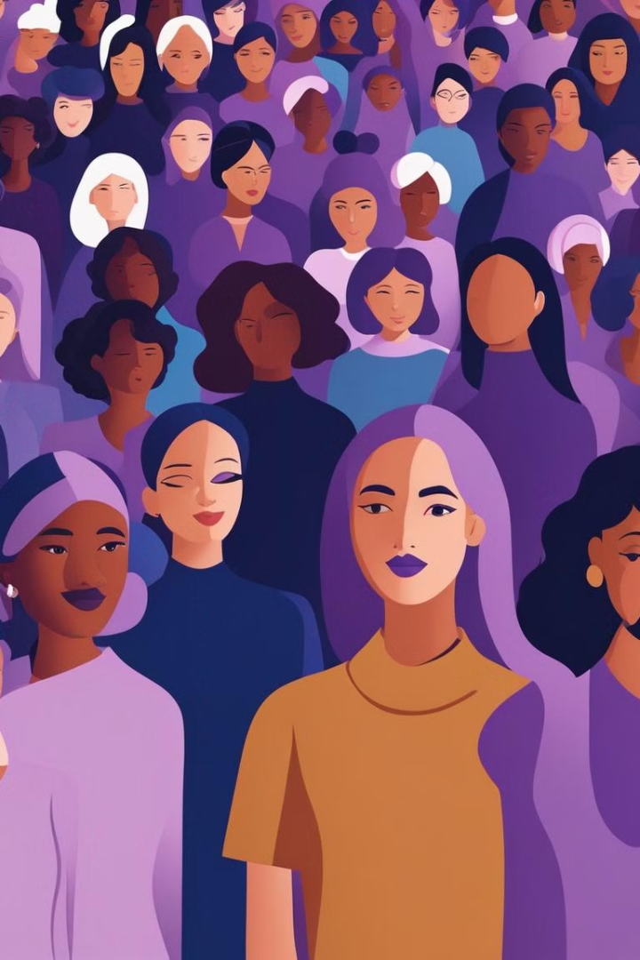


Introduction to Women's Day
Women's Day is a global celebration dedicated to honoring the achievements and contributions of women in various fields. It is a day to recognize their resilience, strength, and impact on society.
by Ritika Sen

Slide 2
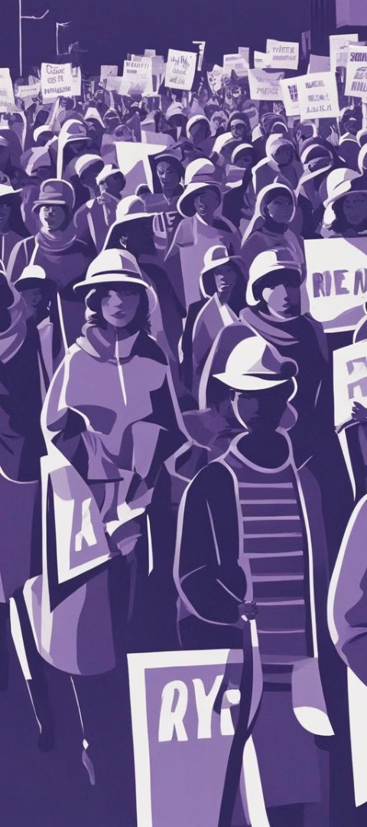
History and Significance of Women's Day
1
Origin
Women's Day has its roots in the early 20th century as a symbol of women's rights and suffrage movements.
2
Official Recognition
The United Nations declared March 8 as International Women's Day in 1977, emphasizing gender equality and women's empowerment.
3
Global Impact
The day serves as a reminder of the progress made and the work that is still needed to achieve gender equality worldwide.

Slide 3



Achievements and Contributions of Women
Scientific Advancements
Inspirational Leadership
Cultural Influence
Female artists, writers, and creators have enriched society with their creativity and unique perspectives.
Women have made groundbreaking contributions to various scientific disciplines, driving innovation and progress.
Women have led impactful movements and initiatives, inspiring positive change around the world.

Slide 4

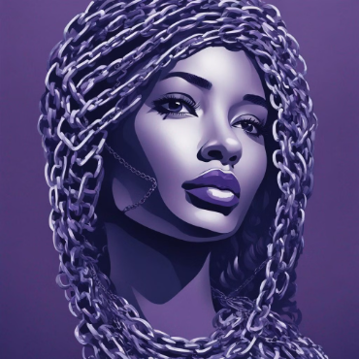
Challenges Faced by Women
Gender Discrimination
Social Stereotypes
Violence and Abuse
Stereotypical expectations and societal norms often limit women's opportunities and choices, creating additional barriers.
Women continue to face unequal treatment and bias in various aspects of their lives, including the workplace and social environment.
Many women are subjected to physical and emotional abuse, highlighting the urgent need for societal change and support systems.

Slide 5

Women Empowerment and Gender Equality
1
Equal Opportunities
2
Advocacy and Awareness
3
Support Networks
Empowering women through education, economic independence, and leadership roles fosters greater gender equality.
Raising awareness about gender-based issues and advocating for policy changes are crucial in advancing women's rights.
Establishing strong support systems and mentorship opportunities strengthens women's resilience and professional growth.

Slide 6
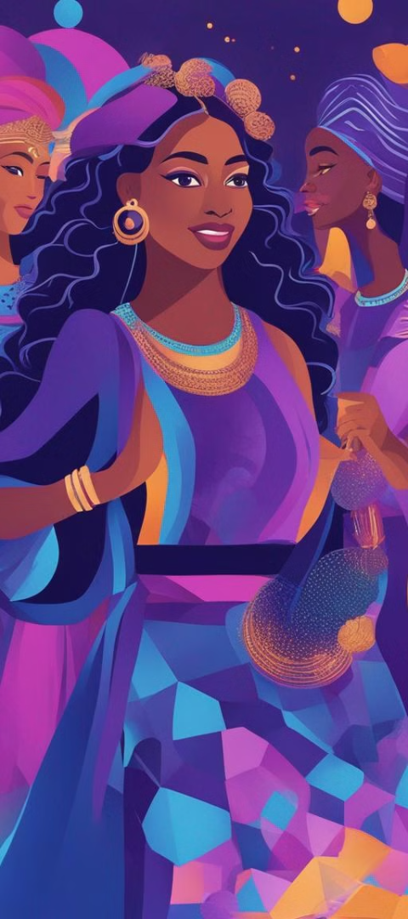



Celebrations and Events on Women's Day
Community Gatherings
Communities come together to celebrate women's achievements, often through cultural events and collective activities.
Panel Discussions
Insightful discussions and workshops focus on gender equality, providing a platform for dialogue and learning.
Artistic Showcases
Creative expressions such as art exhibitions and performances highlight women's voices and narratives.

Slide 7

Inspiring Women Leaders and Role Models
Trailblazers in Business
Humanitarian Icons
Women leaders in entrepreneurship and corporate sectors inspire others with their success and resilience.
Women humanitarians and activists make a significant impact in social justice and global humanitarian efforts.
Cultural Pioneers
Female cultural icons and advocates contribute to positive change and societal progress through their influence.

Slide 8
Conclusion and Call to Action
8
75%
Empower
Awareness
Progress Made
Empowerment
Increasing awareness about women's rights and gender inequality is essential for societal progress.
Recognizing the progress made in achieving gender equality, while acknowledging the work that lies ahead.
Empowering women leads to stronger societies, innovative solutions, and a more balanced world.

